Slide 1
Hidden Dimensions in Chronic Pain
When Pain Frequency Counts More Than Intensity
Alec Painter, University of Cincinnati
Alperen Korkmaz, Wright State University
Richard Sanders II, Wright State University
Notes:
Hello everyone. My name is Alec Painter and I’m here to share the findings of a research collaboration between faculty at Wright State and myself that broadens our understanding of the relationship between chronic pain and psychological risk.

Slide 2
Setting the Scene
Knowns and Uknowns
Notes:
I’ll start by setting the scene a little, establishing the landscape in both the literature and clinical practice, and covering our research questions.

Slide 3
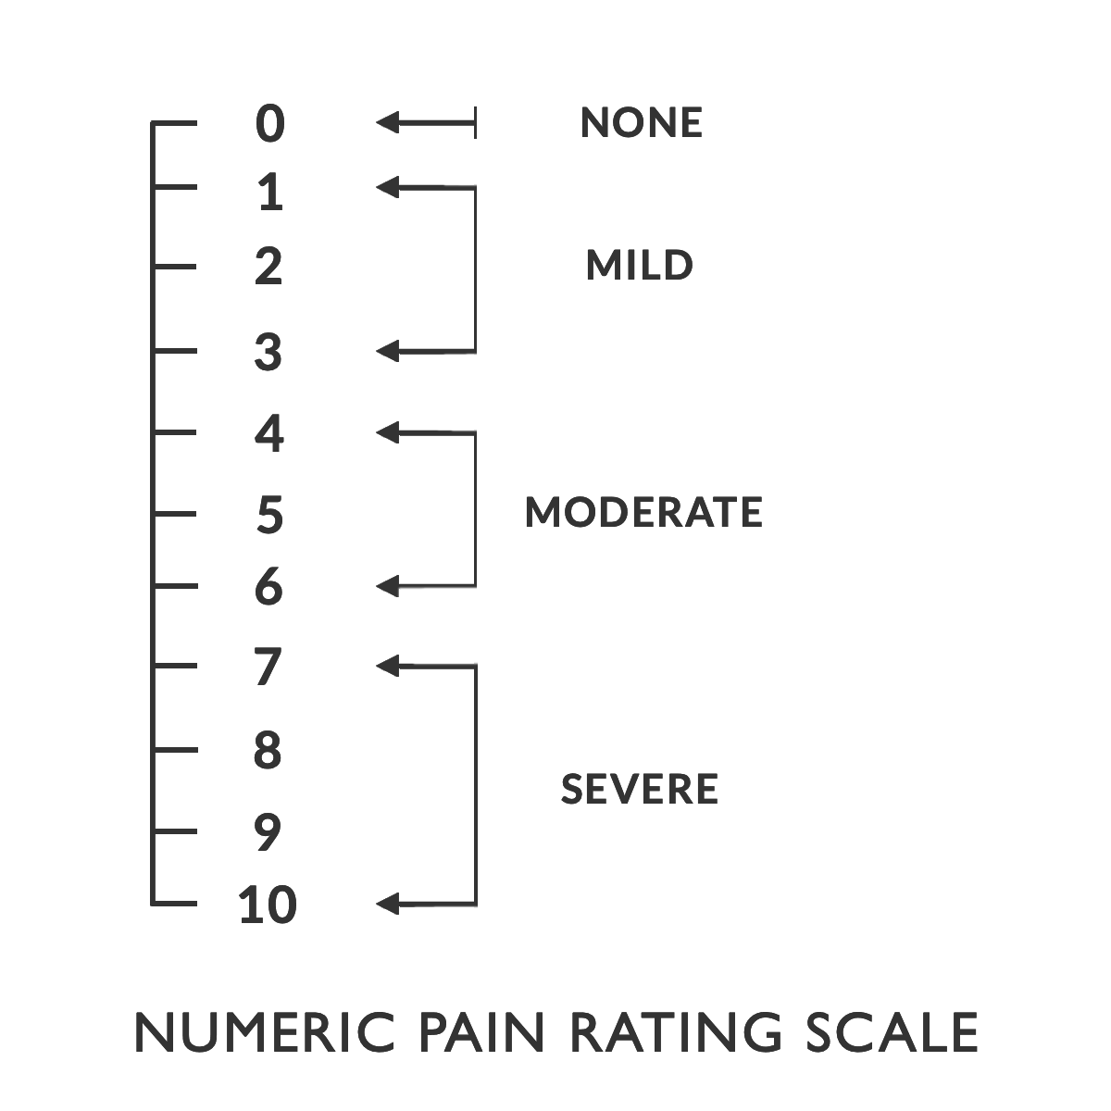

The Established Picture
Chronic pain affects over 50M Americans
Is the leading cause of disability globally
Has significant comorbidity with negative psychological outcomes
Dominant assessment paradigm prioritizes intensity, or “how bad it hurts”
Notes:
One of the most prevalent conditions with known links to severe psychological distress
Affects about 1 in 6 Americans, leading cause of disability worldwide
Well established links to conditions like depression and anxiety, and that it is multidimensional
Traditionally, however, most of the emphasis has been placed on the intensity of chronic pain

Slide 4

Gaps in Our Knowledge
The intensity dimension is well understood, but the other dimensions of chronic pain are not
Pain prevalence changes dramatically over the lifespan, but age effects on outcomes are not clear
Critically: Who can we identify that is at elevated risk for distress that might be missed in an intensity-focused world?
Notes:
There were significant gaps in our knowledge about multidimensional pain symptoms, which formed the basis for our research questions
Frequency of pain is a defining characteristic of chronic pain, but much less research has focused on this dimension
Pain prevalence changes drastically (older adults report 3x more pain), but not investigated in multidimensional fashion
We emphasized clinical translatability throughout, so gaps in screening were a paramount focus

Slide 5
Our Approach
Moving Beyond the 1-10 Scale
Notes:
To answer these questions, and really to push beyond the common numeric rating scales, we followed a five step process

Slide 6
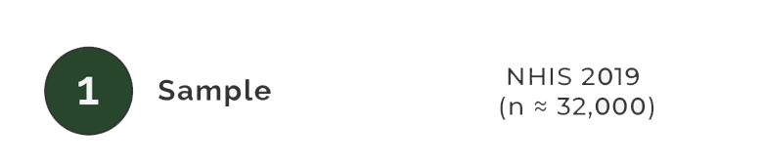
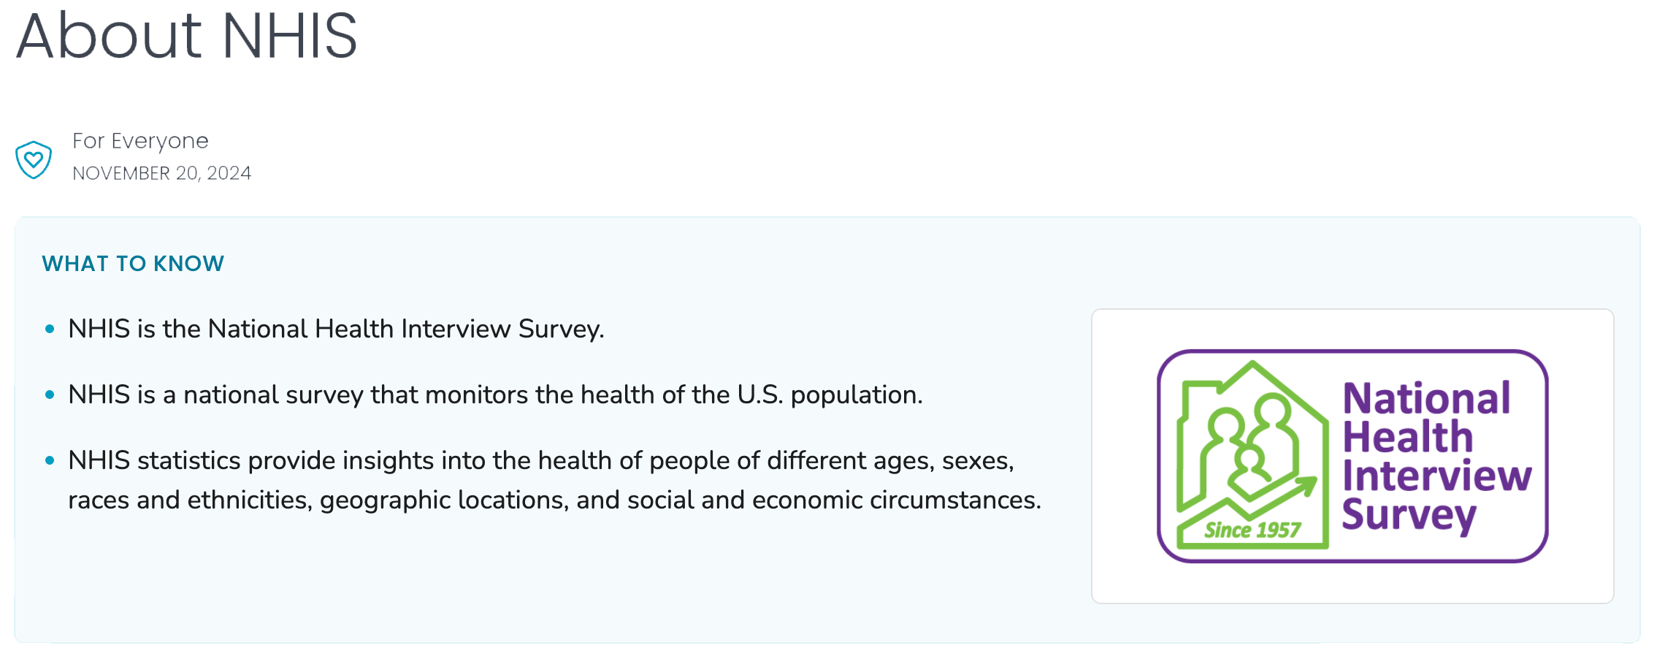
Methods
Notes:
We wanted our findings to most closely resemble what physicians might see in their office, so we chose the NHIS to get population-level, epidemiological data. We focused on data from 2019, which is less recent, but contained information I’ll cover in a minute.

Slide 7
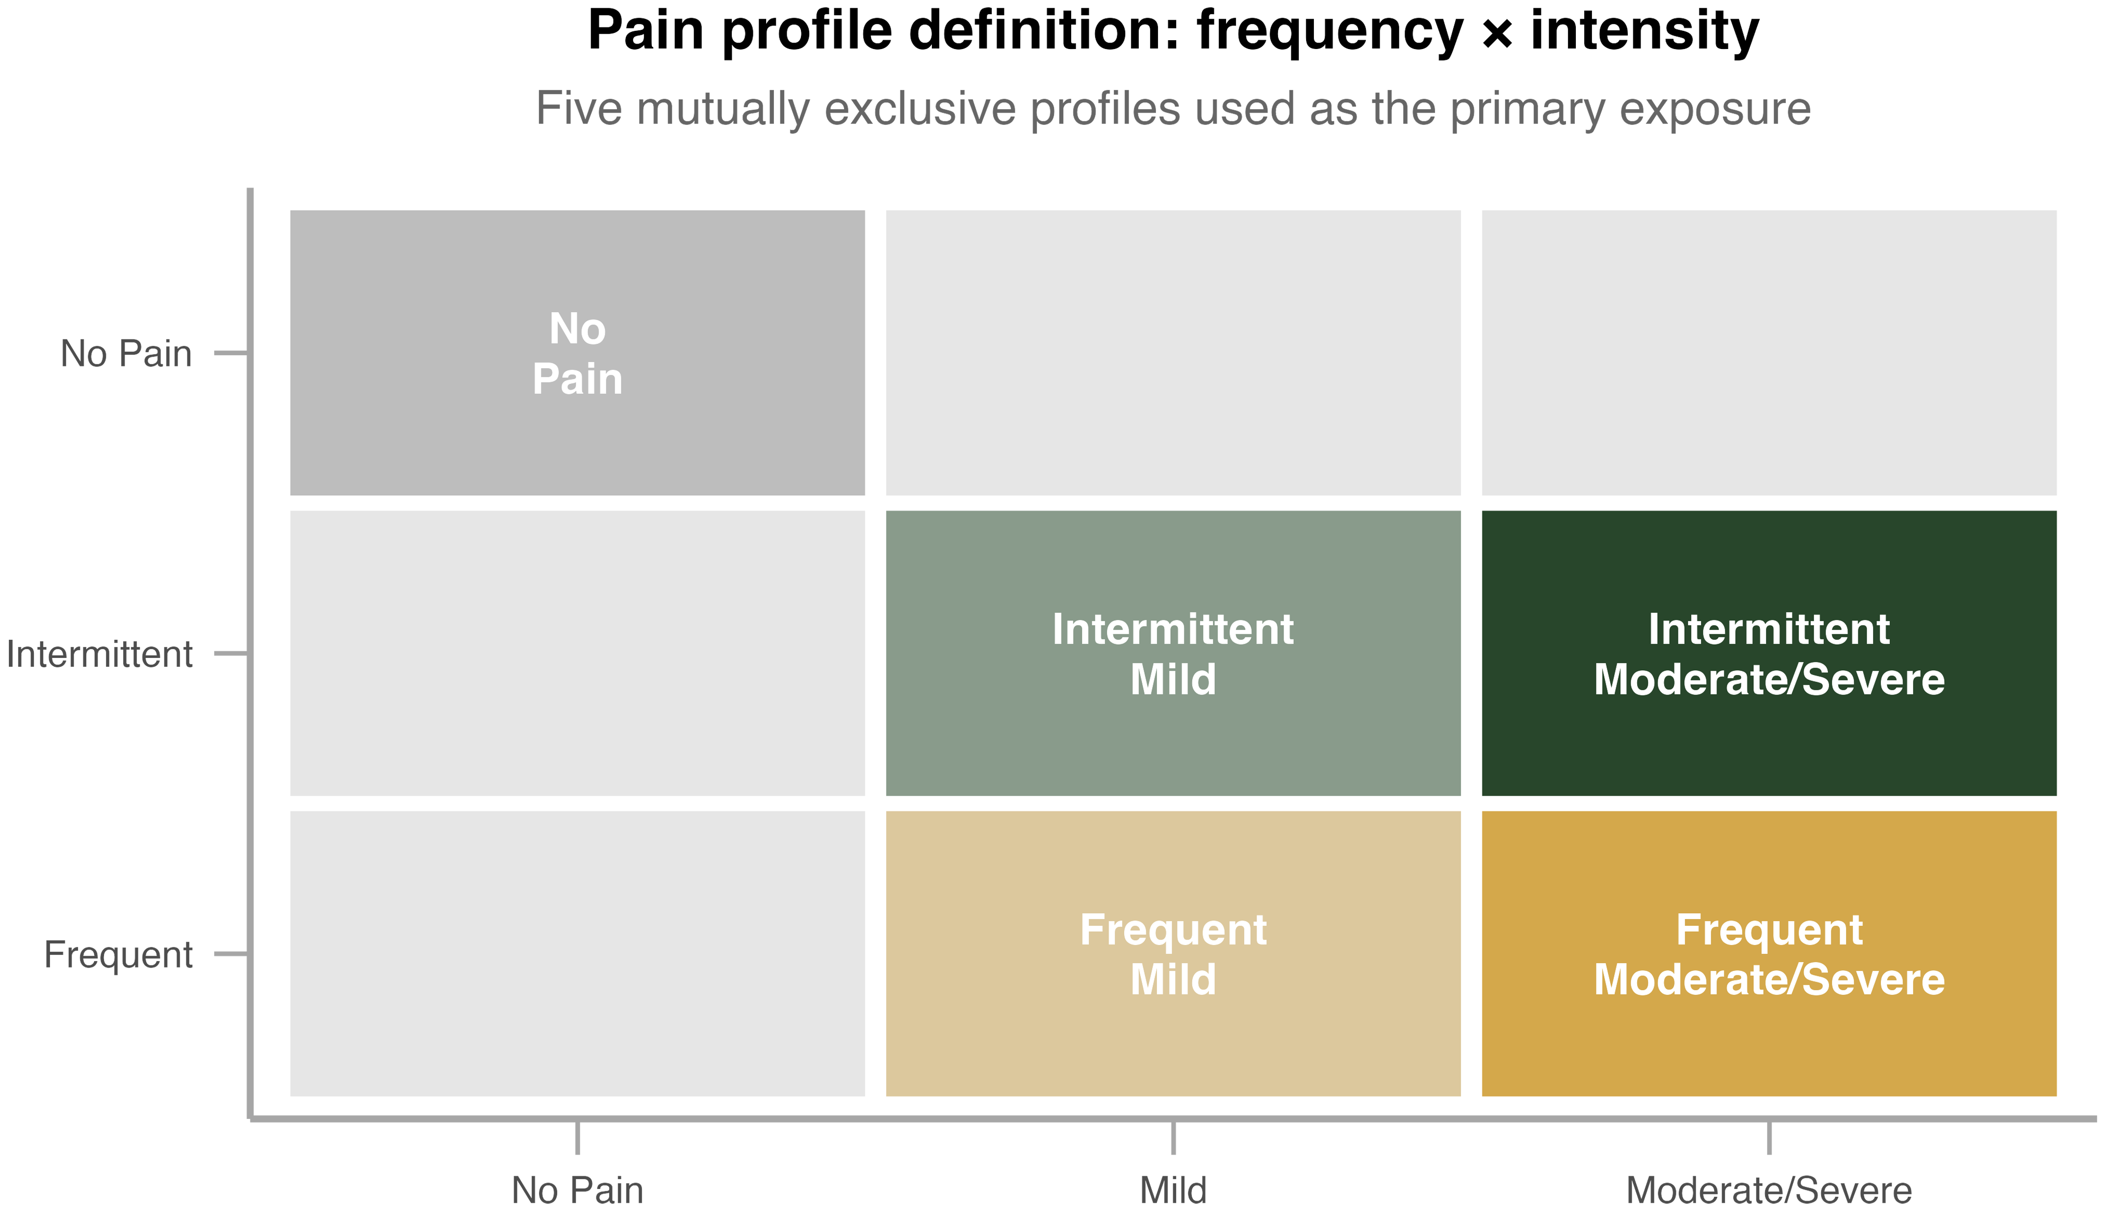
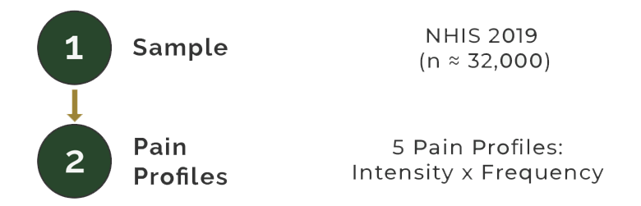
Methods
Notes:
We then developed 5 distinct profiles across chronic pain frequency and intensity:
No pain (baseline)
Intermittent mild pain
Frequent mild pain
Intermittent moderate-to-severe pain
Frequent moderate-to-severe pain

Slide 8
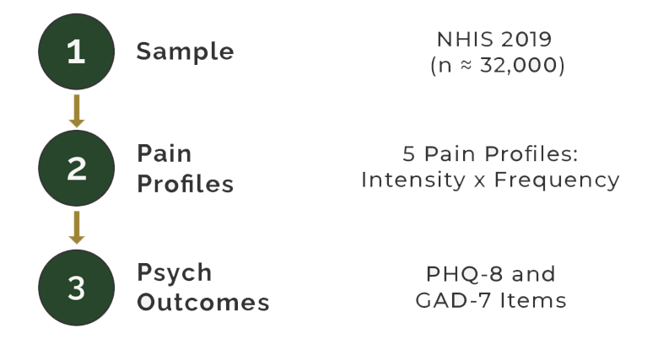
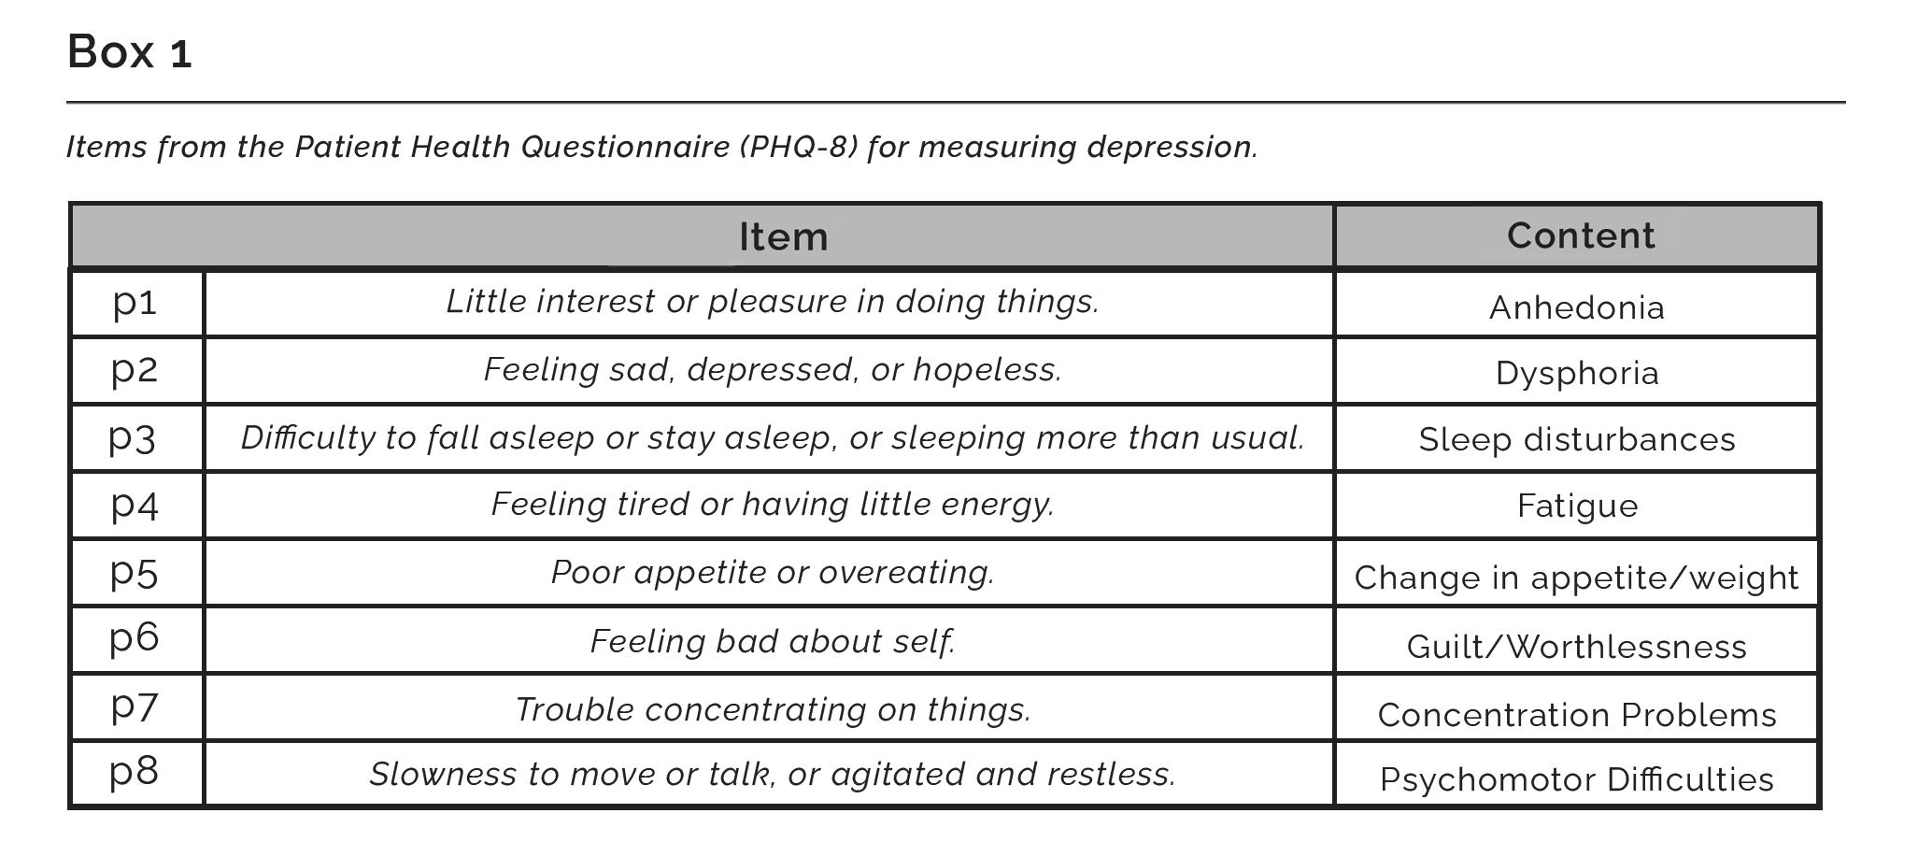
Methods
Notes:
The 2019 NHIS was especially ripe because it used the 8-item Patient Health Questionnaire and 7-item Generalized Anxiety Disorder scale.
Allowed us to not only get total scores for each screener, but break down individual components of depression, which carry their own mortality/disability risk independent of MDD

Slide 9
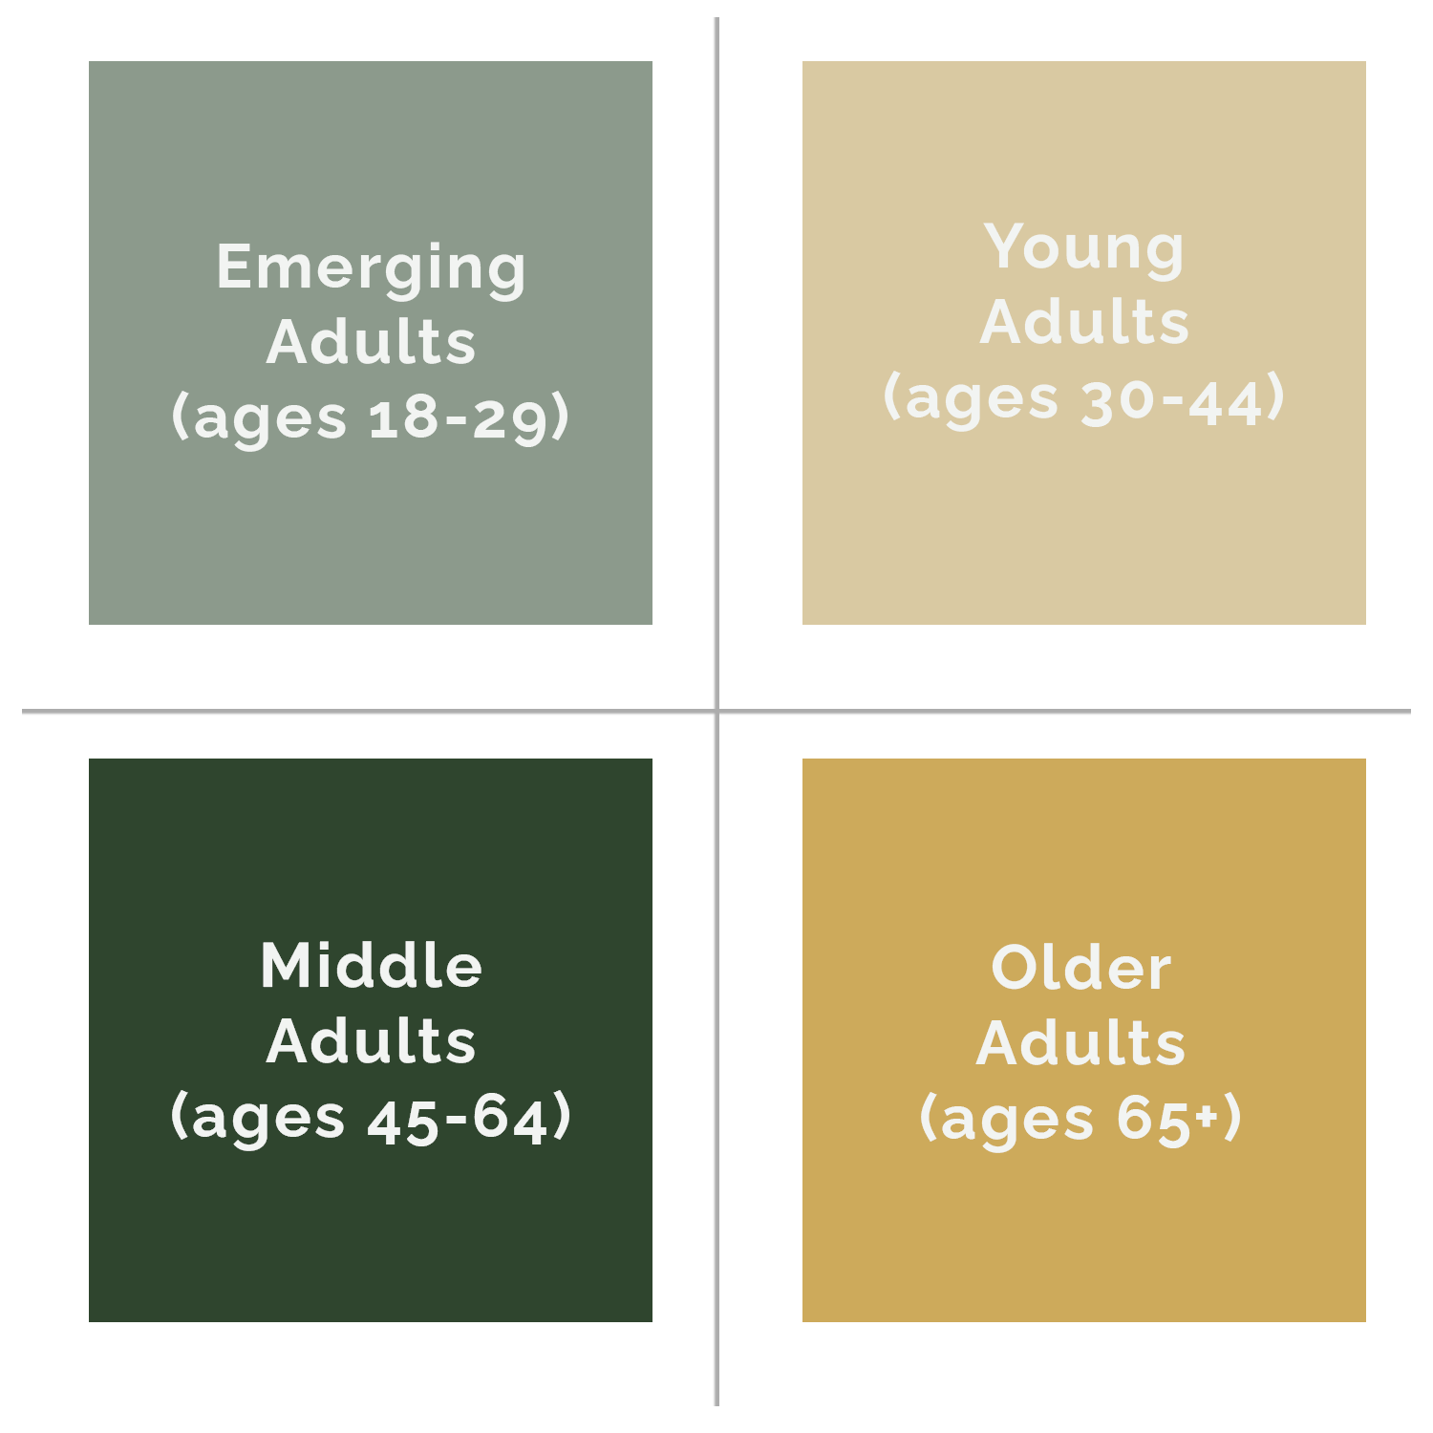
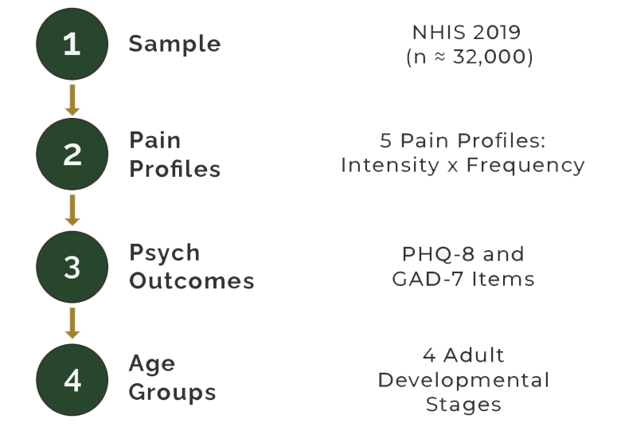
Methods
Notes:
We then stratified the group into the four major adult developmental stages: emerging adults, young adults, middle adults, and older adults

Slide 10
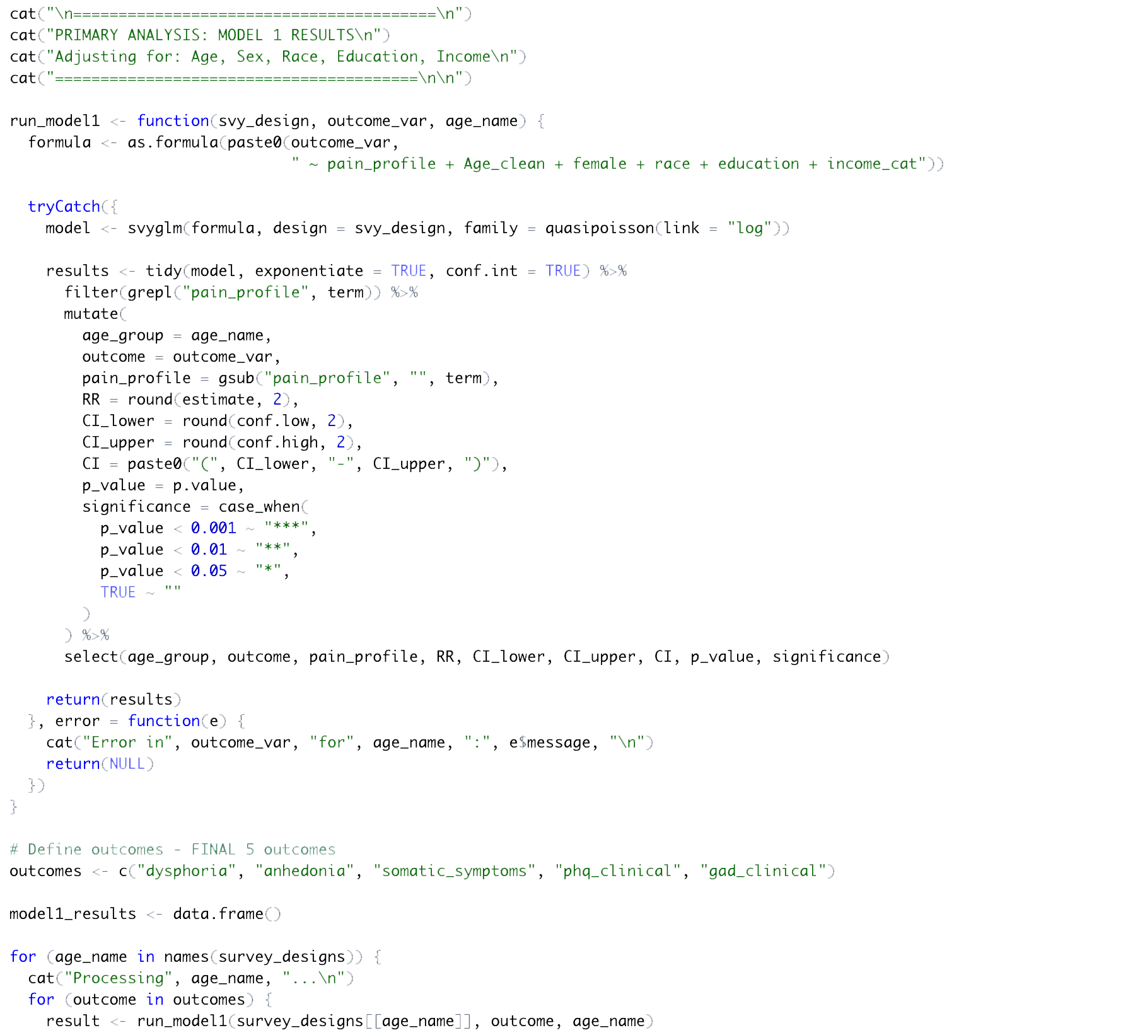
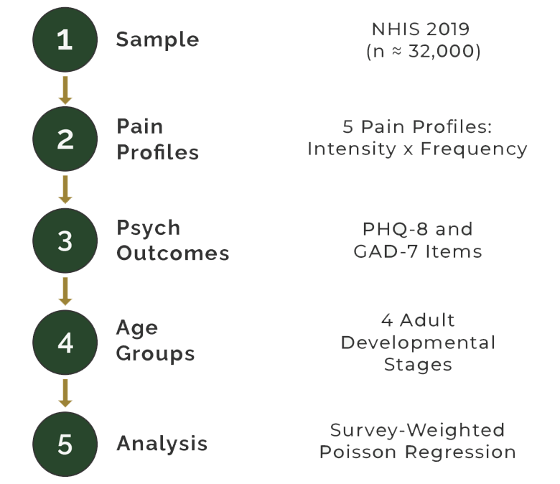
Methods
Notes:
And then we tested using appropriate survey weights, controlling for major demographic factors.
Chose quasi-Poisson because relative risk is translatable to average physician, controls for common outcomes

Slide 11
Key Finding #1
When “How Often” It Hurts Rivals “How Much”
Notes:
Across the 80 different tests we ran, there were several remarkable insights, but I want to focus on two primary findings today, the first of which is the impacts of pain frequency on risk for psychological distress.

Slide 12
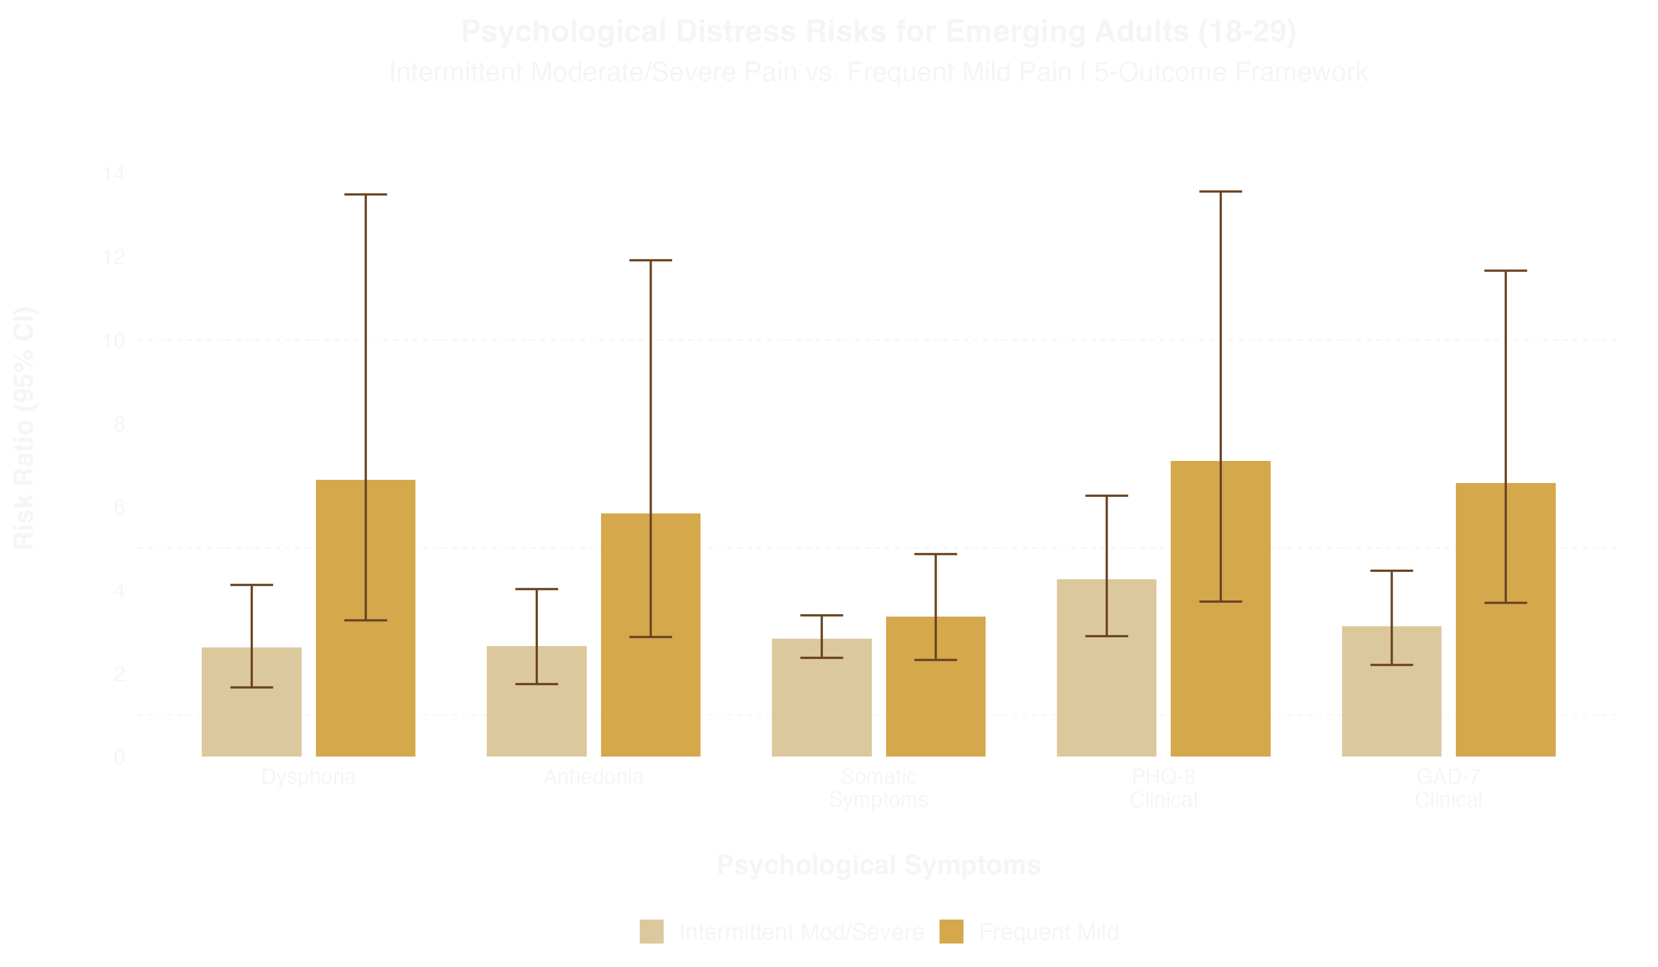
Prioritized by intensity-focused framework
Actually at higher risk for distress
Notes:
Here we see the risk ratios for the 5 outcomes we measured in emerging adults with intermittent moderate to severe and frequent mild pain
Could seem counterintuitive with an intensity-only focus because the person with more pain is at lower risk
In reality, despite reporting only mild pain intensity, frequency was associated with higher risk (2-3x) and might be someone missed for screening

Slide 13
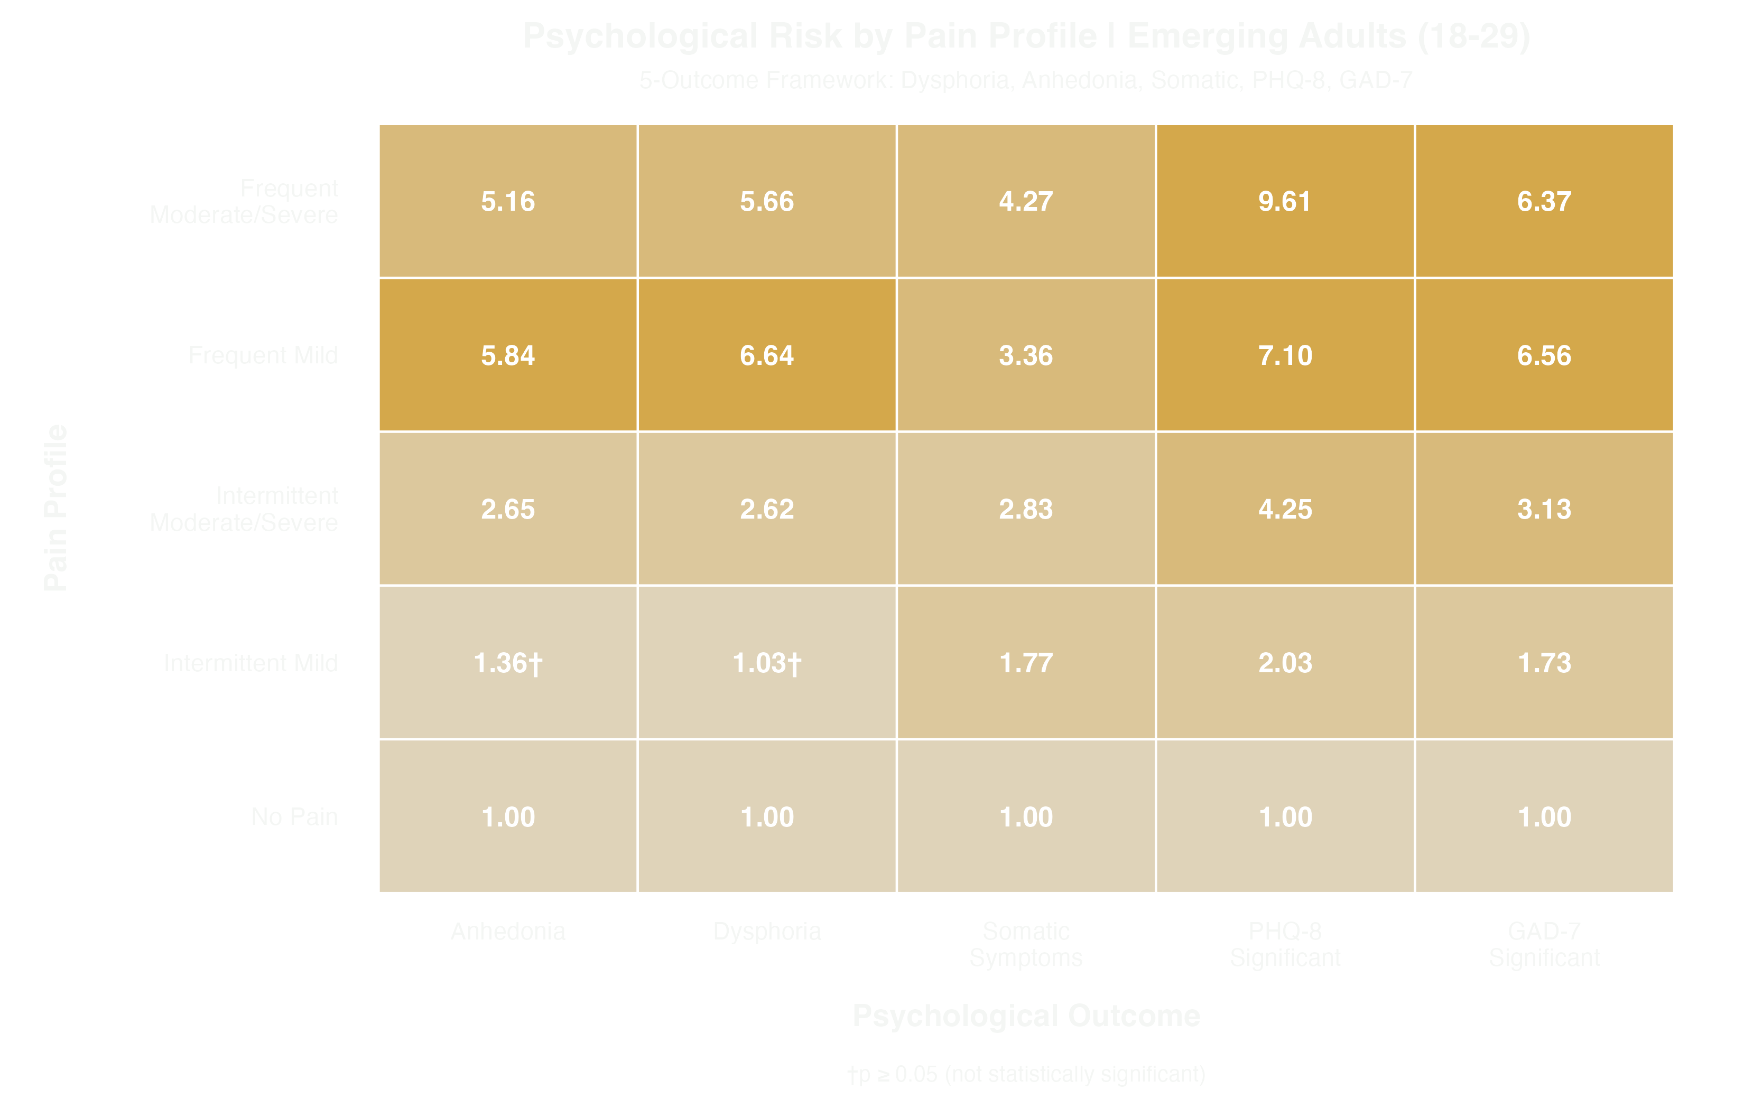
Notes:
Zooming out, we can view the full heatmap of risk for emerging adults
Now comparing Frequent Mild and Frequent Moderate-to-Severe pain
Risk profiles look similar across 5 outcomes, with 3 being slightly higher in those with mild pain

Slide 14
Key Finding #2
Who's Most at Risk - and When
Notes:
The other key finding we’d like to share pertains to the impacts of age effects on the risk profile, which gives us the highest level of specificity for use in clinic.

Slide 15
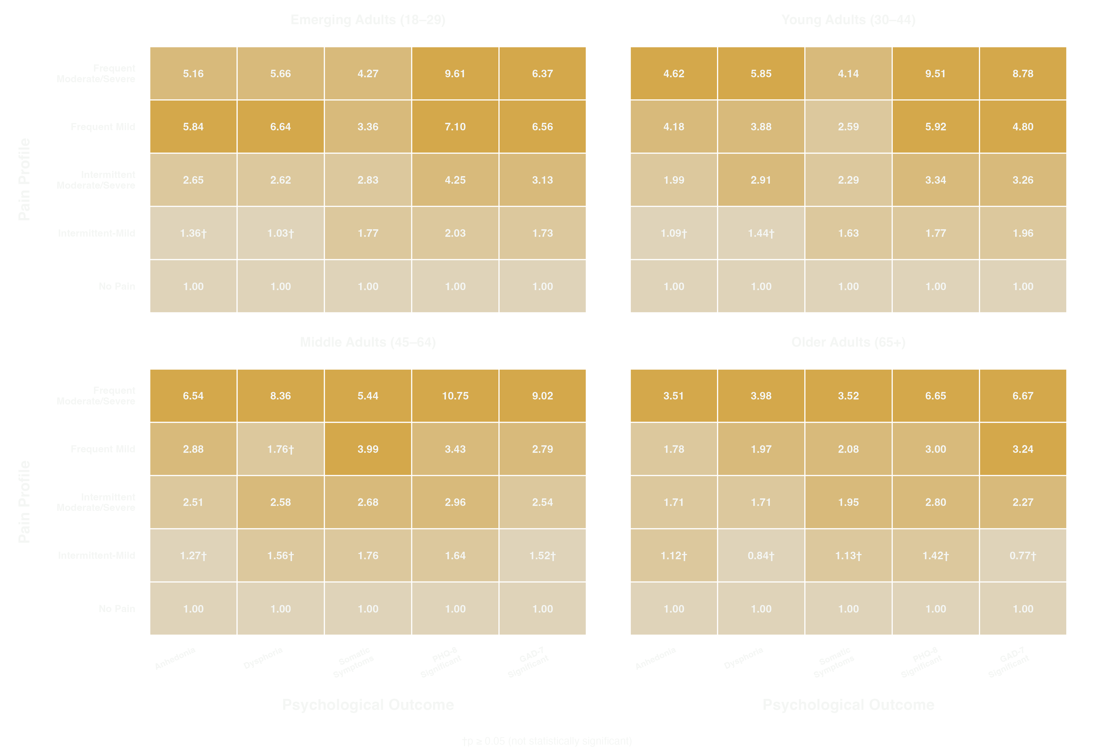
Notes:
My favorite view because of how well it highlights heterogeneity
Starting with frequent mild pain, you can see why I started with the emerging adults example
Interestingly, the second youngest cohort is at the second highest risk

Slide 16
Notes:
Middle adults at the highest risk across all 5 outcomes for the frequent moderate/severe pain profile
Results could indicate “sandwich generation” effects - likely to be caring for children or older parents, highest job demands, strain of also saving for retirement

Slide 17
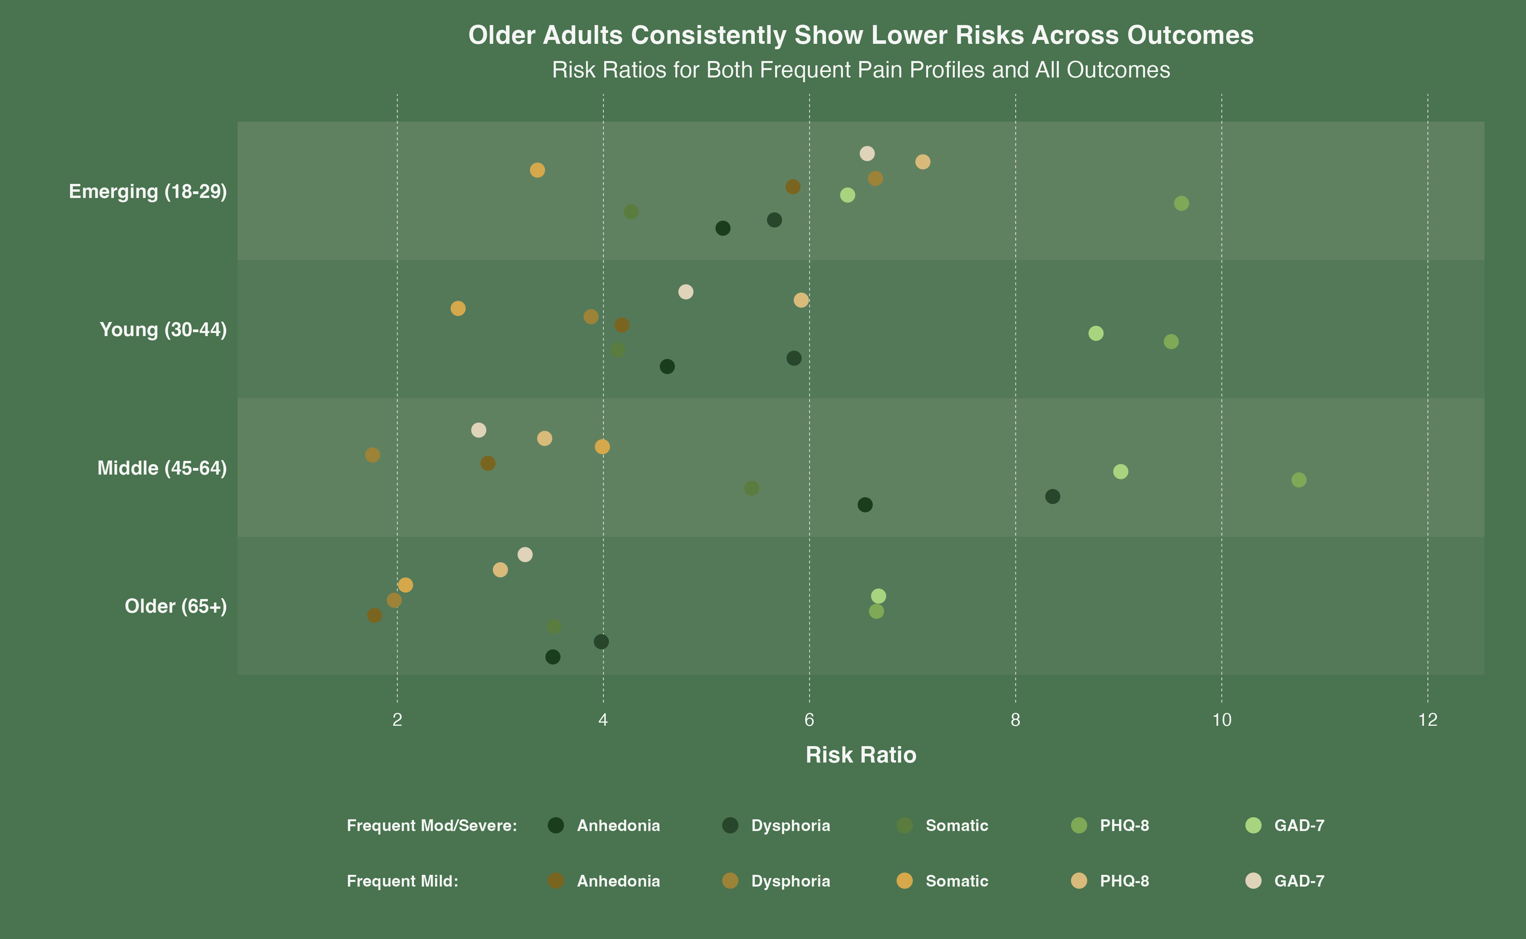
Notes:
Now we haven’t touched on the oldest age group, which report the most chronic pain symptoms but carry the lowest risk for these outcomes

Slide 18
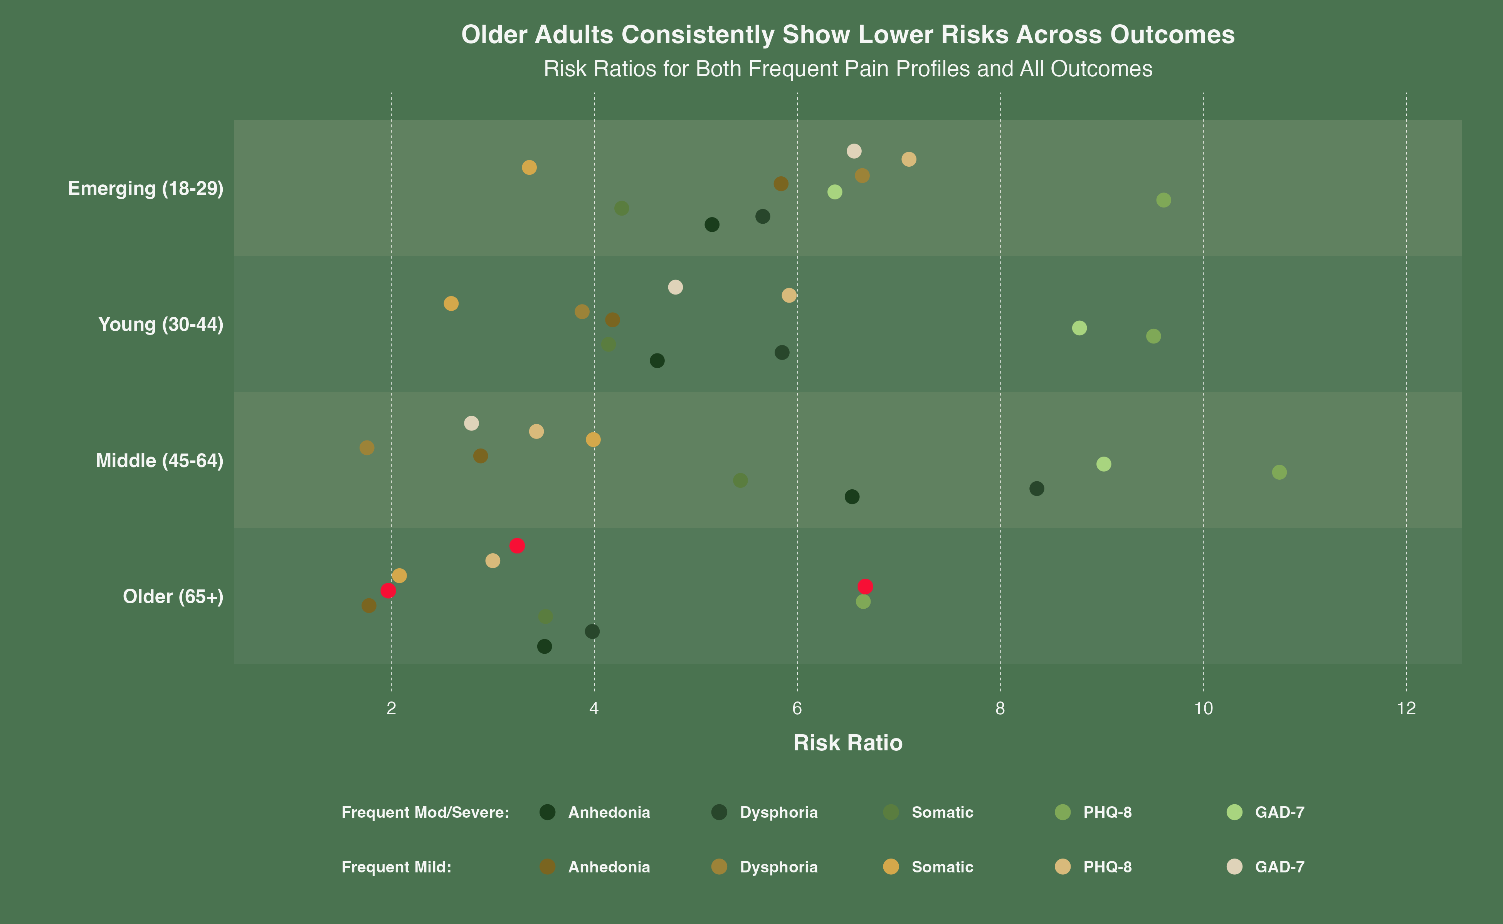
Notes:
There are in fact only 3 outcomes where they were not the absolute lowest risk of the four groups, and were never the highest
Some researchers call this the geriatric pain paradox - high pain prevalence but relative resilience.
Studies are continuing, but causes point to possibilities like fewer life demands, socioemotional selectivity, or that pain is just more in line with their expectations in life
I can’t tell you how many times I’ve heard the older men in my life get up after sitting for awhile, brace their lower back, and say “I’m getting old”

Slide 19
Limitations & Model Stability
Stress-Testing Our Results
Notes:
Now, no studies are without their limitations or are excused from stress-testing, so I’ll take a minute to cover our limitations and go over the robustness of our models.

Slide 20
Limitations
NHIS is cross-sectional data and we cannot imply directionality. Pain may worsen distress, distress may amplify pain, or both could share causes.
It only captures one additional dimension, limiting phenotyping ability. Additional dimensions like duration of episodes would provide more insight.
Pain symptoms were self-reported with a 3-month recall window, introducing the potential for bias.
Notes:
NHIS is cross-sectional only, so we cannot tell you how all of these dimensions interact with one another outside of their indication for higher risk
The survey only added the frequency dimension for our purposes, limiting phenotyping potential
Need something for bias potential

Slide 21
Notes:
VERY BRIEFLY RUN THROUGH OR SAVE FOR QA
We ran 80 tests across pain profiles and outcomes, so multiple testing correction needed to be applied
We ran Bonferroni do all 80 tests, raising out p-values for significance from the recognizable 0.05 to something 80x more stringent
Even with that excessively high bar, 71% of results survived the stress test

Slide 22
Clinical Implications
From Abstract to Exam Room
Notes:
I mentioned that we maintained a clinician-forward perspective to maximize how this could translate to screening practice, so I’d like to cover a few points there and also offer a glimpse of what that could look like in the future

Slide 23
Clinical Implications
Clinicians need to ask at least one additional question during screening:
“In the past three months, how often did you have pain? Would you say never, some days, most days, or every day?”
Patients with frequent pain, even if they report is as mild, need the same clinical attention as those with more severe pain
Age-stratified risk: younger patients with frequent, mild pain and middle-aged patients with frequent, moderate-to-severe pain are the two highest risk categories
Notes:
This can seem like an overwhelming amount of data, but during patient visits, it boils down to one additional question
Err on the side of caution when pain symptoms are frequent, regardless of intensity
If a young patient with frequent, mild pain or middle aged patient with frequent and more intense pain walk into your office, prioritize them for screening

Slide 24
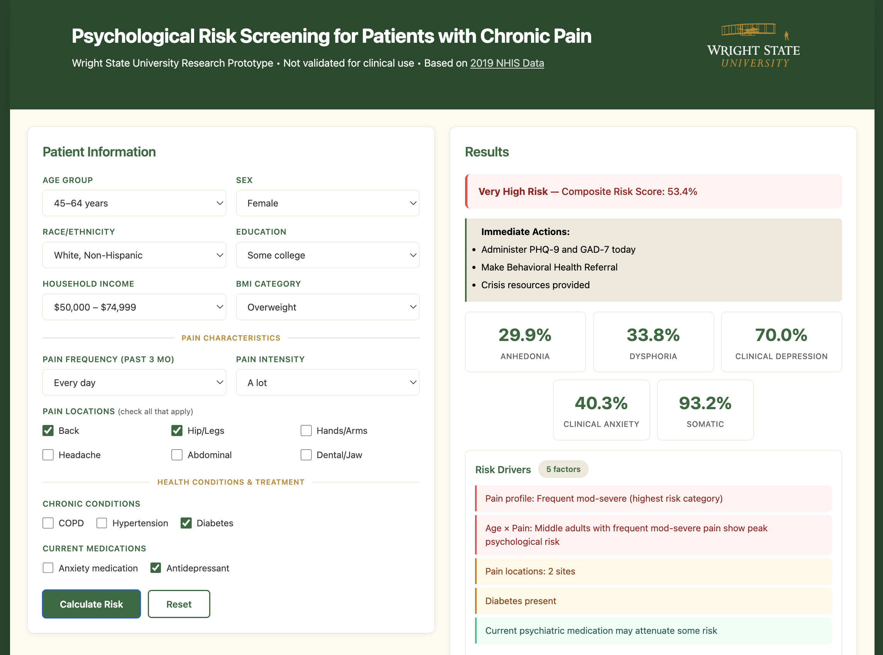
Notes:
Now, I thought it would be a little uncool to show up and put out a call for adding additional time spent screening without thinking about how to remove obstacles
I won’t have enough time during the presentation for a live demo, but if you catch me before I leave, I am happy to let you take it for a test drive
It’s not clinically validated, so think of it more as a thought starter than anything else
The main goals were to lower the new burden on clinicians, provide them insights about their patient and the tools to know more, and protect privacy as well
It uses only non-identifiable inputs that a clinician would have ready access to and could enter in a minute or two before generating a risk profile

Slide 25
Notes:
Once they’ve hit Calculate Risk, the information to the right populates with more information about the patient
It’s information about the risk for developing any type of problem the subcomponents we’ve been talking about, some info about the analysis that caused this, and a few actions they might want to consider

Slide 26
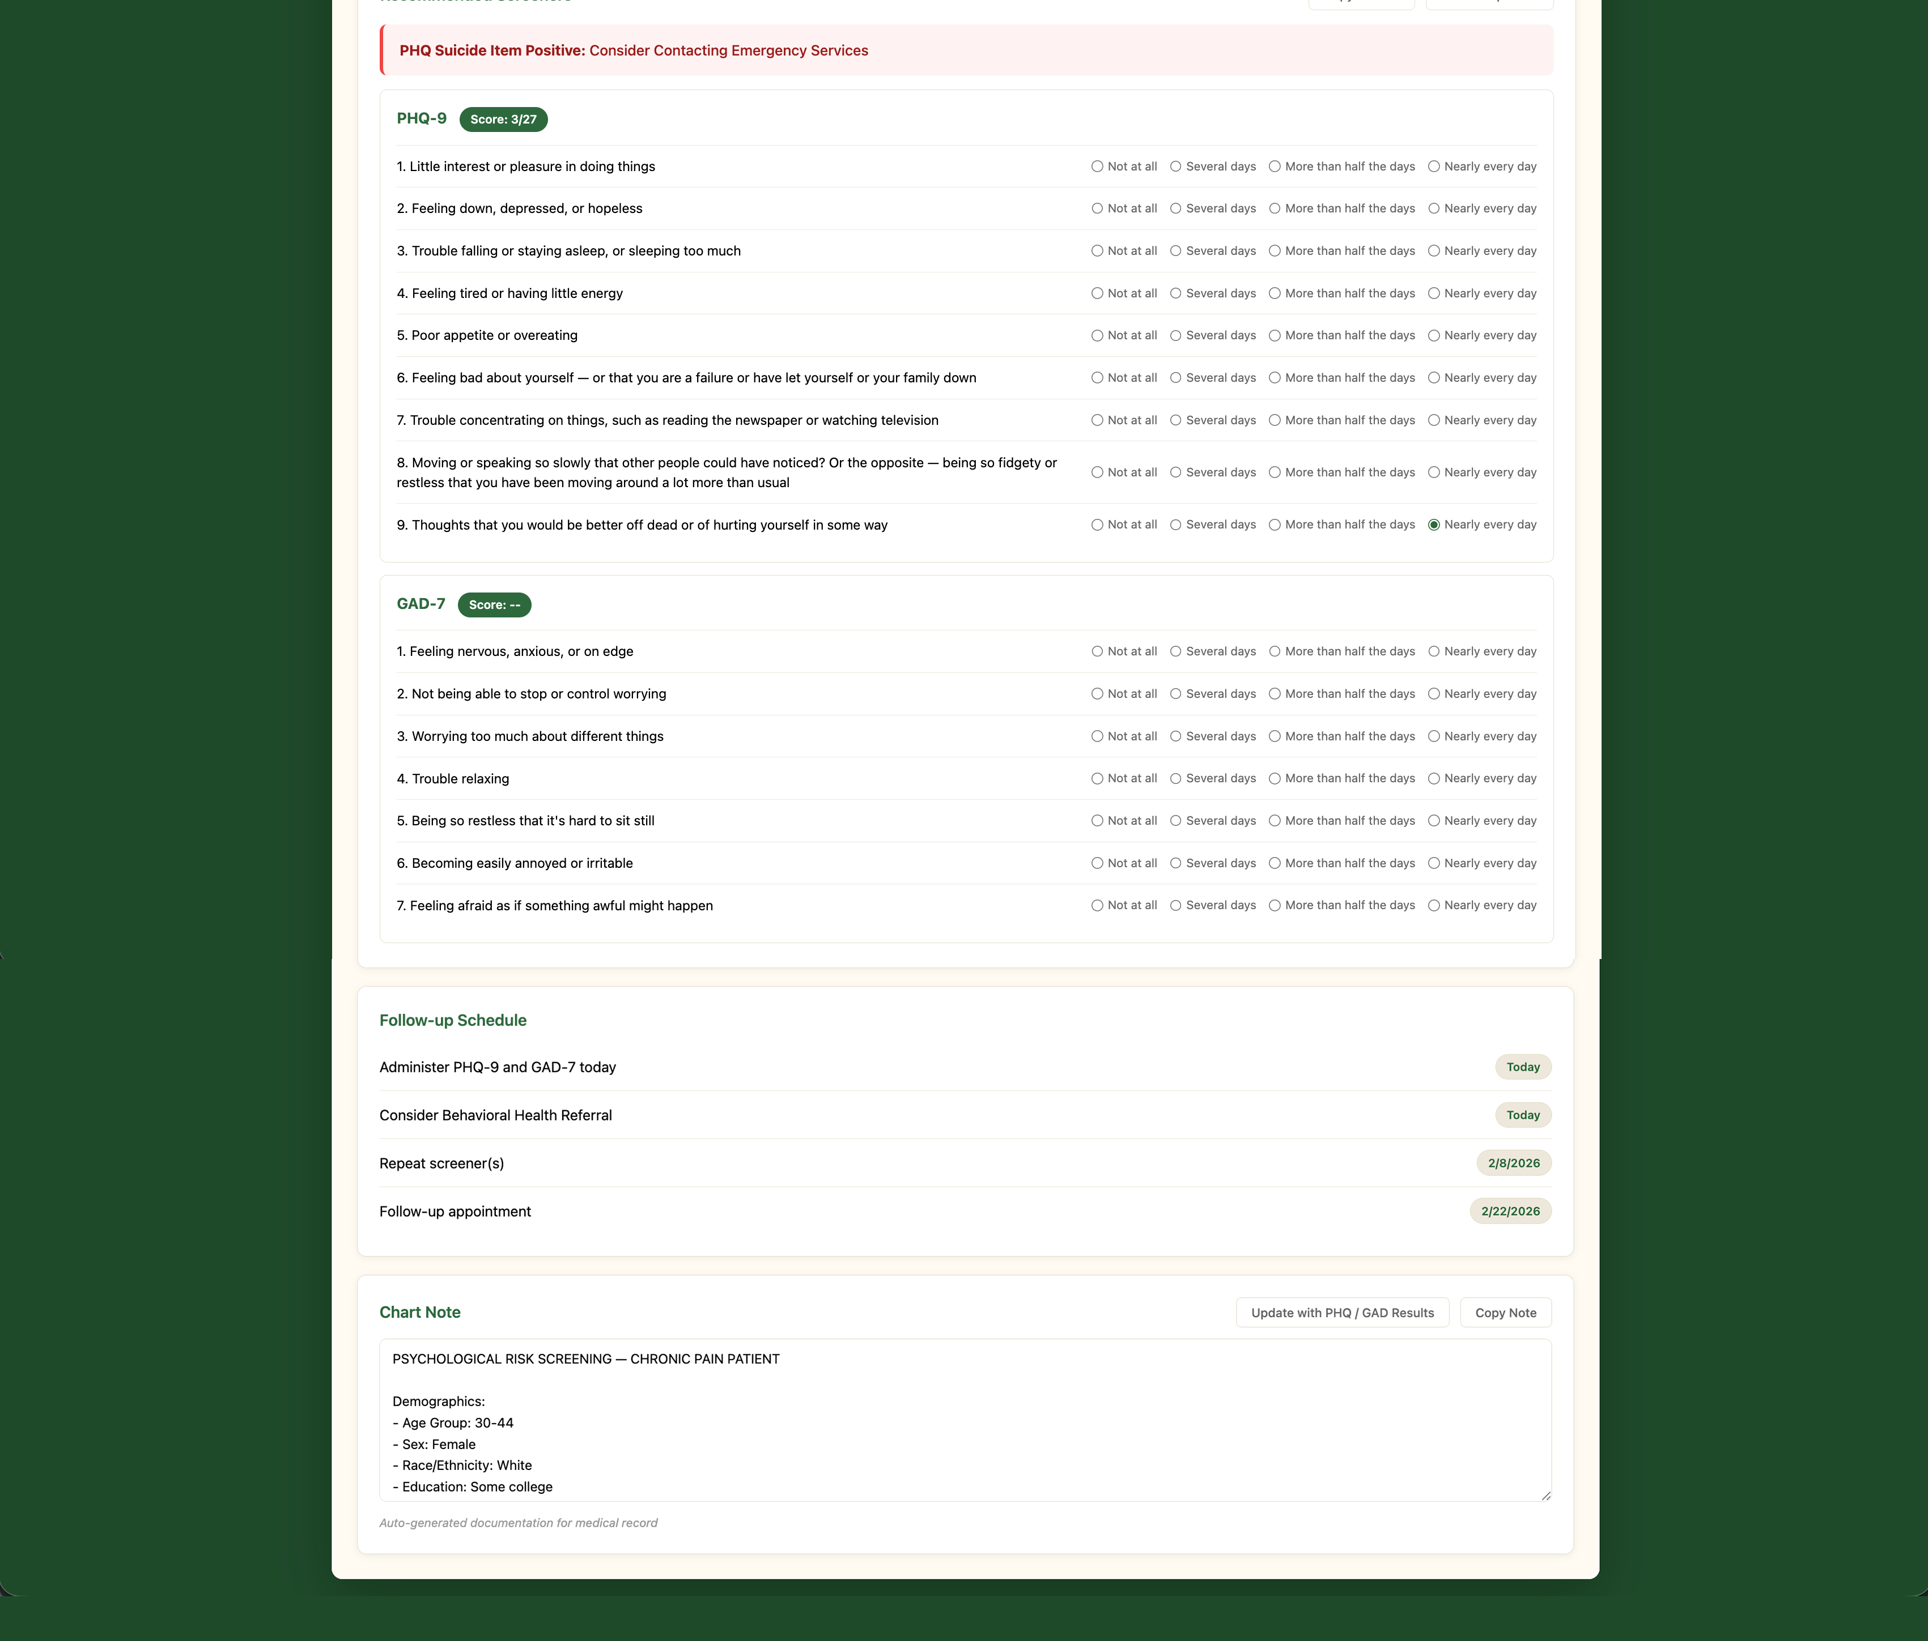
Notes:
Since a large number of clinicians someone with chronic pain might not be familiar with psychological screening or have those instruments on hand, the instruments are delivered right in the tool for use during the visit if needed
Scores auto-calculate to cut down on the time and potential for error related to manual scoring, and a red flag warning appears if the patient has indicated a risk for self-harm

Slide 27
Notes:
The last two modules are related to planning and documentation, which are both automated as well, but can be edited
Copying the chart note and makes marrying the data with identifiable info and record keeping as easy as possible when pasting back into a patient’s chart

Slide 28
Thank you.
alecpainter@gmail.com
alecpainter.me/pain_screener
Notes:
Thank the audience, Dr. Sanders, and Alperen
Provide contact info and URL

Slide 29
Appendix

Slide 30
Notes:
SAVE FOR QA
Chronic pain and psychological distress are impacted by countless things not included in our analysis, so we ran an E-values analysis to see how large some unmeasured confounder would need to be to explain away our results
If you’re unfamiliar, you can look at an e-value of 2, which is typically what you see for the association between hypertension and stroke, and read it as “that mystery confounder would need to be twice as impactful as this analysis to explain the results”
In the case of the frequent mild pain we’ve discussed today, all but one of the associations (middle adults x dysphoria) were significant

Slide 31
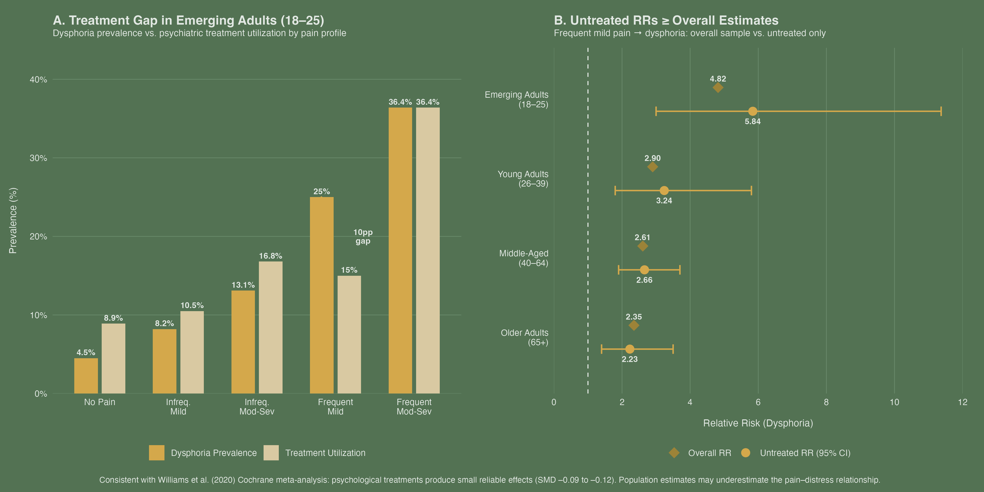
Notes:
SAVE FOR QA
If reports of distress were linked solely to higher treatment utilization, we’d expect to see similar rates for frequent/mild group, but there’s a 10% gap
We tested interactions for untreated individuals to see if the RRs attenuated, but they increased relative to the entire group

